Slide 1
ICT Academy of Kerala
Building the Nation’s Future
Orientation on
Full Stack Development Training Program
Muthoot Institute of Technology And Science, Varikoli
Day 03
August 16,2018
Notes:
Eg.ICTAK Learning Center, Technopark
Eg. August 6, 2018

Slide 2
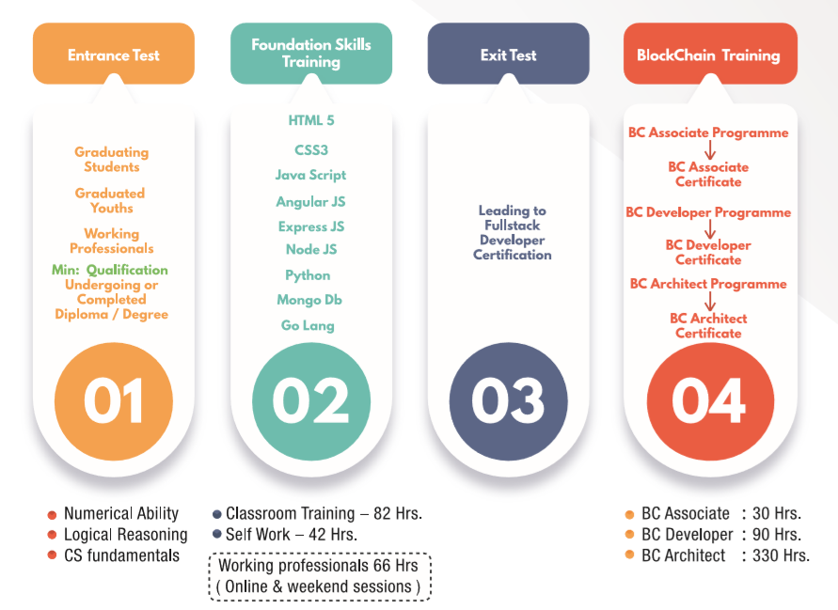


Notes:
After welcoming participants to the venue start the power point presentation.
This slide has two images (1st image: Congratulations and 2nd image: ABCD training flow)
Congratulate the students for clearing stage 1 (entrance examination).
Let’s go through the names of 9 technologies covered in Stage 2 (HTML5 to GoLang). Also mention about Stage 3 the exit test which is based on FS developer program.

Slide 3
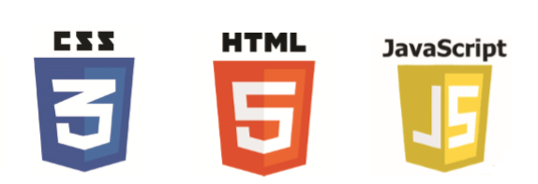


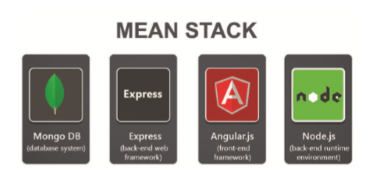
Foundation Skills Training
Notes:
Let the participants have a close look at the 9 technologies discussed in Stage 2 (FS development). Ask them “Is that easy to learn 9 technologies in 14/15 days?”
(Don’t go for a discussion….expect a yes or no answer and check which is the majority). We will justify/clarify it in the coming slides

Slide 4

Know Each Other
Notes:
Take 10-15 minutes for this. Ask the participants to introduce them by saying the following:
Name
Place
Educational Qualification
Experience (if any)
Motivation to join this program

Slide 5
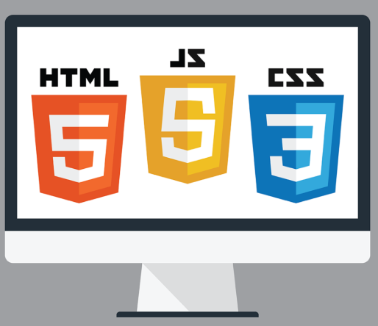
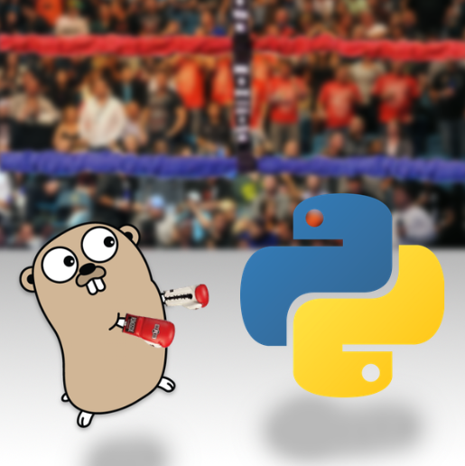

1
3
2
9 Technologies
Notes:
Now its our turn to explain how to learn 9 technologies in 14/15 days.
Confirm if all the participants received the detailed program schedule. (ICTAK share it to all participants during program orientation)
The 14/15 days training is completed in a duration of 30-40 days. The technologies are covered in different slots so that the participants get enough time to learn and practice the topics discussed in the sessions).
We see the 9 technologies as 3 different levels:
HTML+CSS+JavaScript
MEAN
Python and Go Programming

Slide 6
Prerequisite
Skill++
MEAN Stack Developer
Objectives???
Notes:
More on the flow of the 3 levels discussed above:
MEAN as the core of Full-stack training that discusses MongoDB, Express JS, Angular2 and Node JS.
HTML+CSS+JavaScript as the Pre-requisite for FS training…
Python and Go as two programming languages that help them in future….since Python is used is almost everything nowadays (Data analytics, to IoT applications to web applications….GoLang is helpful for Blockchain development)
Also mention GoLang is given as self-learning module.

Slide 7

What is
MEAN Stack
Development?
Notes:
Check whether they are confused about the term MEAN stack development
We will be explaining what is MEAN stack development in the next slides…..

Slide 8

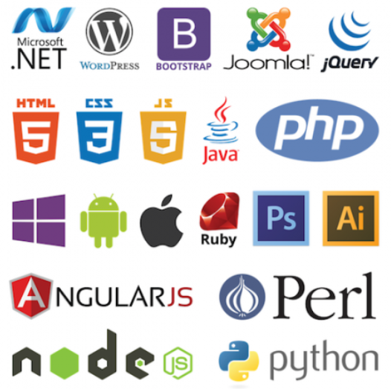

Web Application Development Technologies
Notes:
To know about MEAN stack development one should understand the terms like:
Web Application
Web Application Development
Web Application Development Technologies
We will be explaining each of them in the coming slides…..
Mean time, if any participants can answer to the queries initiate a discussion and cover the topics (no necessary to use the slides)

Slide 9
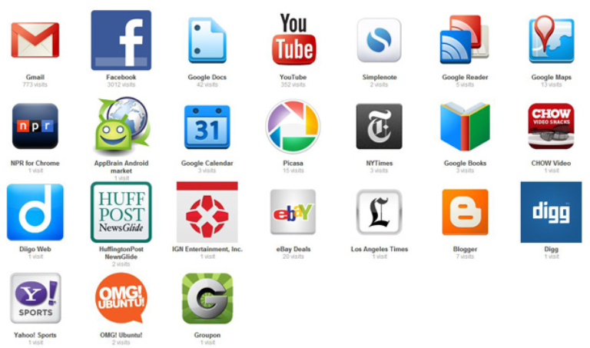
Notes:
Ask the students about the websites they are using everyday.
Knowingly or Unknowingly they all use web applications in their daily life….
Ask them how they access a web application….!!
Expect the answer from someone….”through a browser”

Slide 10

Notes:
Explain the flow of web applications in general.
Discuss about brief ideas on BROWSER, SERVER and DATABASE

Slide 11
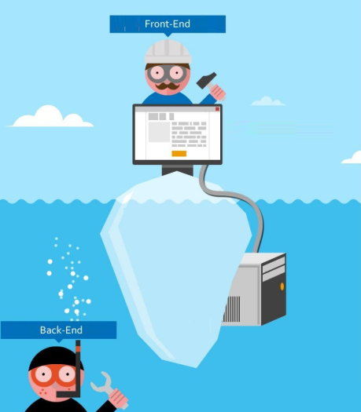

Slide 12
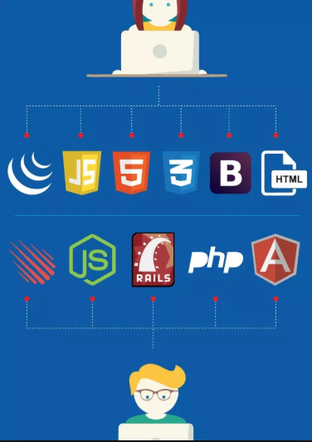
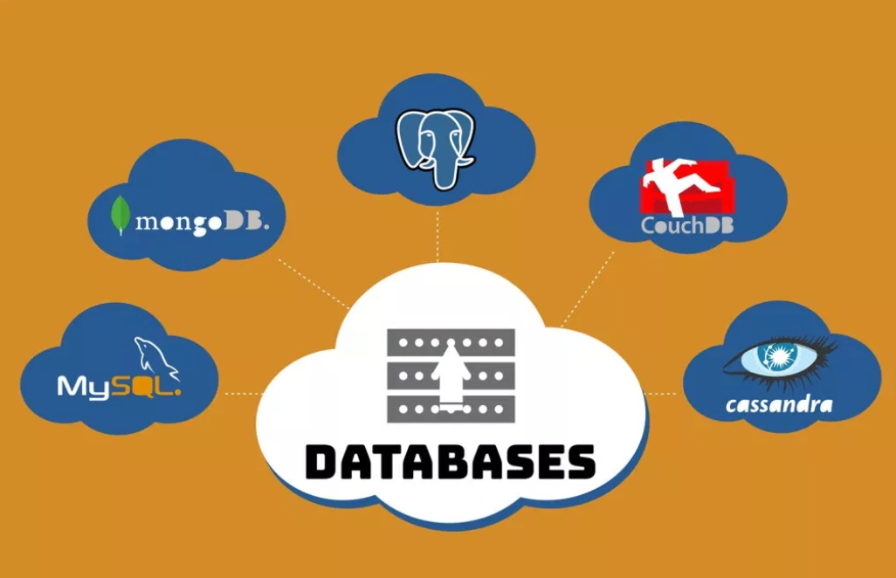
Web Application Development Technologies

Slide 13
How to Choose
the Right Technologies for
Web App Development?

Slide 14
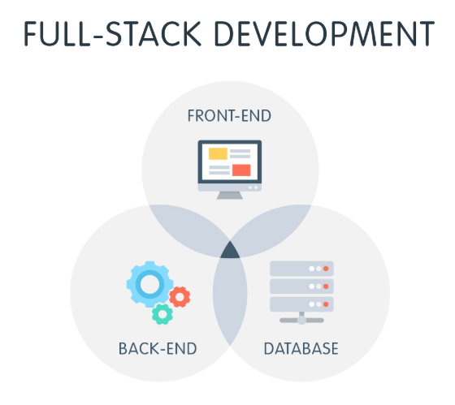

Slide 15
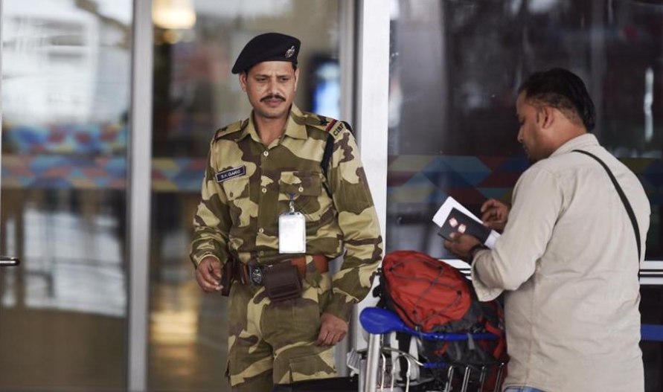

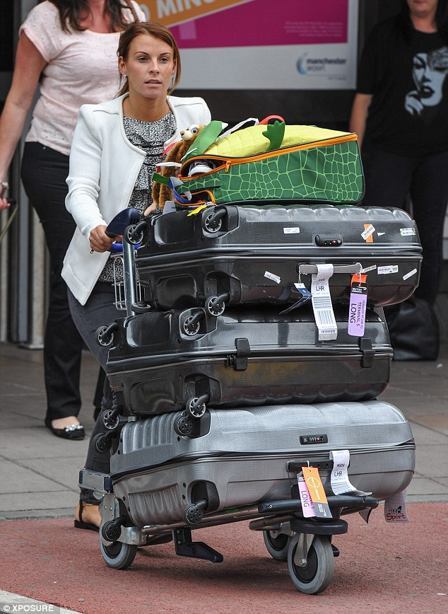

MEAN Stack Analogy

Slide 16

MEAN Stack Analogy

Slide 17
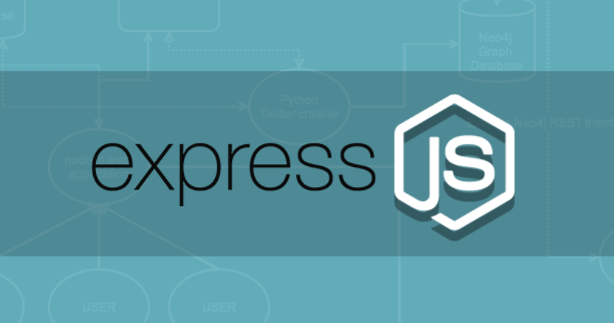
MEAN Stack Analogy

Slide 18

MEAN Stack Analogy

Slide 19

MEAN Stack Analogy

Slide 20
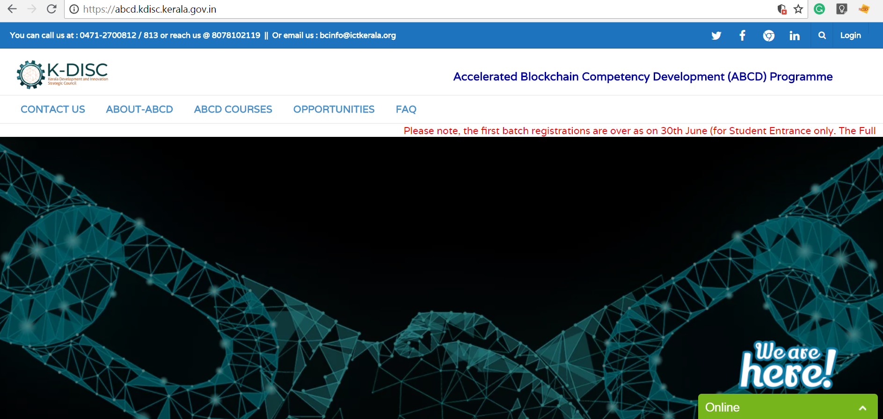
LMS
www.abcd.kdisc.kerala.gov.in

Slide 21
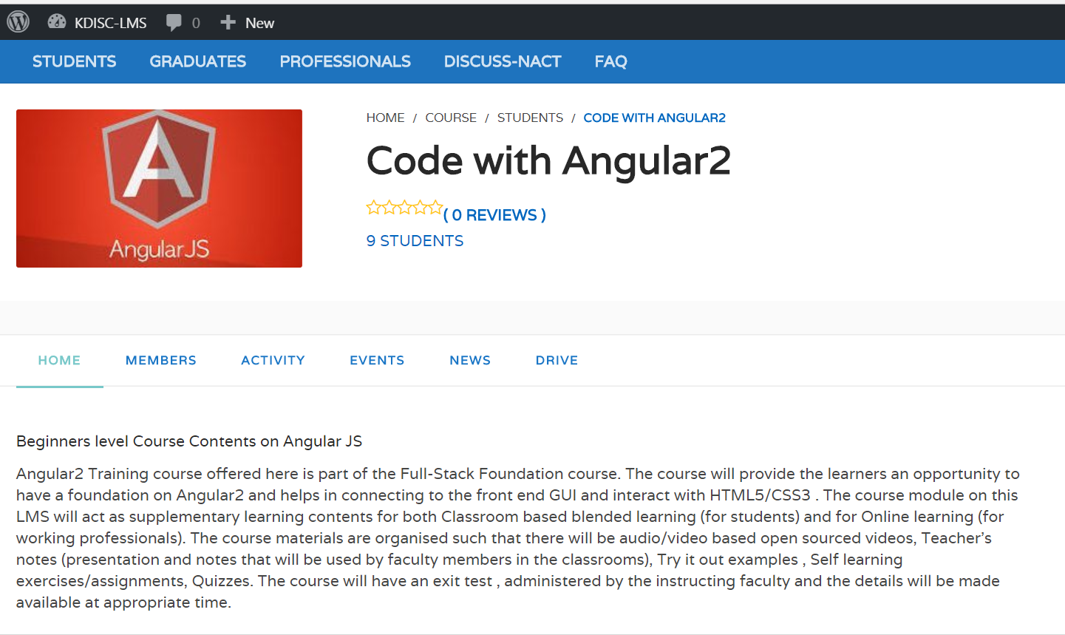
LMS

Slide 22
